Slide 1
Protecting User Password Keys at rest (on the Disk)
Category : System software, File security
Team Scope : Developing a application to encrypt and decrypt the files of the user.
Pre-requisite : Linux operations, Crypto Algorithms. Any programming language is suited for system software like C,C++,Python,Java.

Slide 2
Unique Idea Brief (Solution)
To enhance the security of user passwords keys stored on disk by implementing a system using AES-256 encryption for robust security.
Utilize a passphrase-based key derivation function (PBKDF2) to generate encryption keys from user pass phrases, enhancing protection against brute force attacks. Store keys and salt securely ,using random bytes for key generation and salts to prevent attacks.
Encrypt files and directories by encrypting their content and securely storing encryption keys with user derived keys.

Slide 3
Features Offered
AES-256 Encryption :
1)Uses AES-256 in CFB mode for encryption and decrypting.
Random key generation :
2)Generates a random 256-bit (32byte) key for encrypting file content.
Passphrase-Based Key Derivation:
3) Uses PBKDF2 to derive a key encryption key from a user-provided passphrase and a randomly generated salt, adding an extra layer of security.
Secure Storage of Encrypted Keys:
4)Stores encrypted keys in separate ‘.enc.key’ or .enc_key’ files.
Automatic File Management:
5) Handles renaming and moving files during encryption/decryption processes.

Slide 4
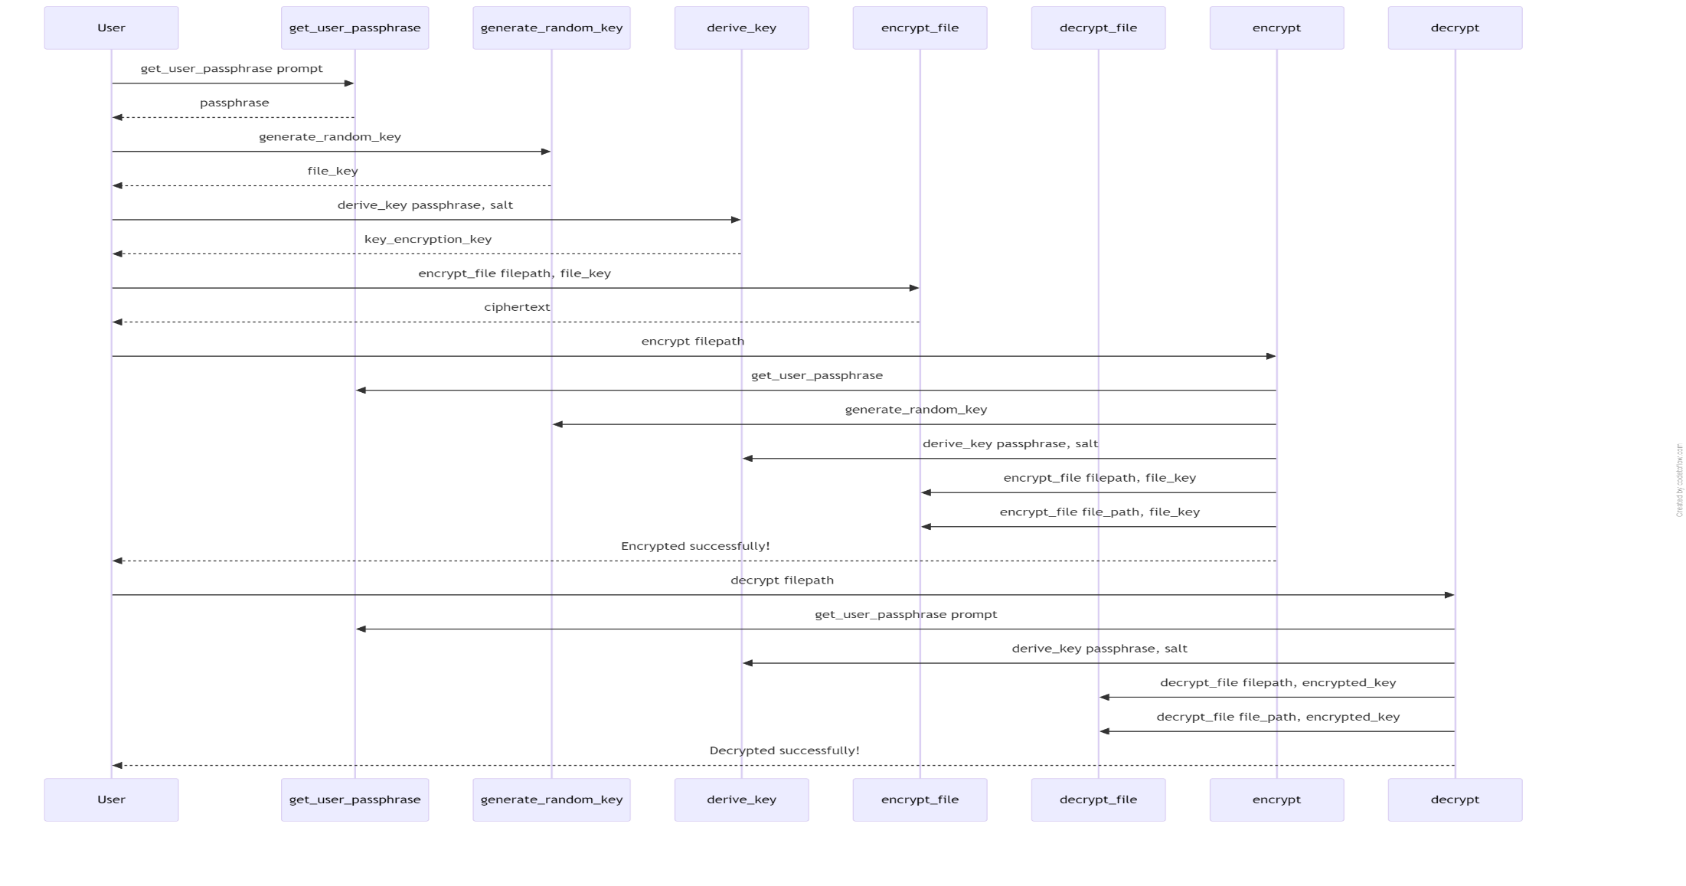

Slide 5
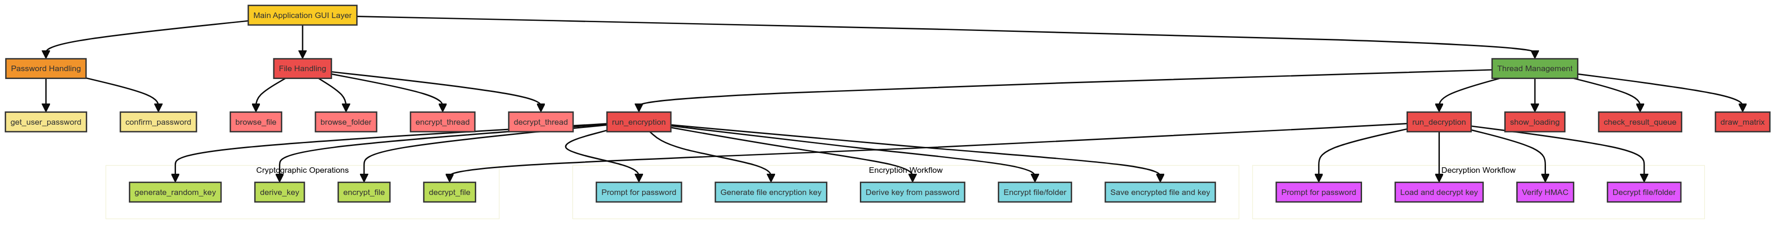
Architecture Diagram

Slide 6
Technologies used
1)Tkinter:
tkinter: Python's standard GUI (Graphical User Interface) toolkit for creating and managing windows, dialogs, buttons, etc.
Modules and classes used: tk, tk.Frame, tk.Label, tk.Entry, tk.Button, tk.Toplevel.
Submodules used: tkinter.filedialog (for opening file and folder dialogs), tkinter.messagebox (for displaying message boxes), tkinter.simpledialog (for simple dialogs).
Threading:
threading: Used for running tasks concurrently with threads (Thread).
queue: Used for communication between threads (queue.Queue).
Cryptography Libraries:
Crypto.Cipher.AES: From the pycryptodome package, provides AES encryption and decryption (AES.new).
Crypto.Random.get_random_bytes: Generates cryptographically secure random bytes (get_random_bytes).

Slide 7
Team members and contribution:
Bollineni satish Chandra kumar
Cryptography and Security Implementation
Design and implement encryption and decryption algorithms using AES-256 in CFB mode.
Develop key management functions, including key generation and derivation using PBKDF2 and HMAC for integrity checks.
Ensure secure password handling and user authentication.
Develop recursive directory processing for encryption and decryption.
SKILLS: Strong understanding of cryptography, Python programming, and security best practices. Proficiency in file system operations, experience with multithreading in Python, and problem-solving skills.
Akhil Sodinapalli
GUI Development
Design and implement the graphical user interface.
Create and manage GUI components such as entry widgets, buttons, progress bars, and message boxes.
Implement visual effects like the "Matrix" style display using the Canvas widget.
SKILLS: Experience with GUI development, familiarity with ‘tkinter’ and user-friendly design.

Slide 8
Conclusion
I have implemented robust encryption and decryption algorithms using the Advanced Encryption Standard (AES) in CFB mode. Recognizing the critical importance of strong key management, I have integrated PBKDF2 for deriving secure keys from passwords and utilized HMACs for data integrity verification
In terms of file operations, I have extensive experience in manual manipulation of files and directories. This includes reading, writing, and securely deleting files, as well as recursive management of directories.
My proficiency in Python programming has been strengthened through extensive work with standard libraries for system interactions and third-party integrations, leveraging advanced functionalities.
Regarding security, I have implemented secure user authentication mechanisms to safeguard sensitive operations. This includes ensuring that passwords are handled securely and never exposed in plaintext during input.

